Slide 1
U.S.-Colombia TPA
Short Supply Mechanism (Mecanismo de Escaso Abasto)
August 9, 2018
Richard Stetson and Laurie Mease
Office of Textiles and Apparel (OTEXA)
U.S. Department of Commerce
Notes:
GOOD MORNING –
MY NAME IS RICHARD STETSON. I AM JOINED BY MY COLLEAGUE, LAURIE MEASE. WE WORK FOR THE OFFICE OF TEXTILES AND APPAREL AT THE U.S. DEPARTMENT OF COMMERCE.
I AM HAPPY TO SAY THAT I HAVE VISITED YOUR BEAUTIFUL COUNTRY ON VARIOUS OCCASSIONS. IN 2004 AND 2005 I PARTICIPATED AS A MEMBER OF THE U.S.-COLOMBIA TPA NEGOTIATING TEAM. DURING THESE NEGOTIATIONS, WE AGREED TO DESIGN A SHORT SUPPLY MECHANISM TO HELP DEVELOP TRADE IN THE REGION WITH COMMERCIALLY VIABLE RULES OF ORIGIN AND SENSIBLE FLEXIBILITIES.
THE SHORT SUPPLY MECHANISM IS ONE OF THE FLEXIBILITIES THAT WAS ADOPTED TO ALLOW THE TRADE TO CONTINUE TO DEVELOP EVEN WHEN CERTAIN TEXTILE INPUTS WERE (OR ARE) NOT COMMERCIALLY AVAILABLE IN COLOMBIA OR THE US.

Slide 2
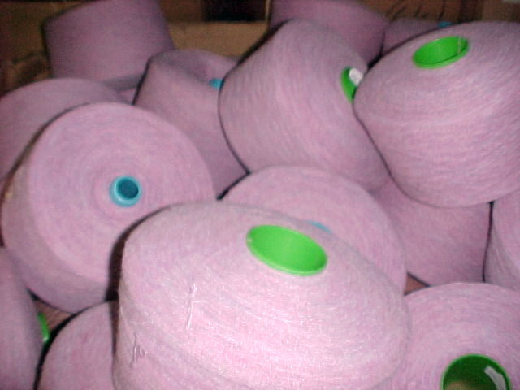

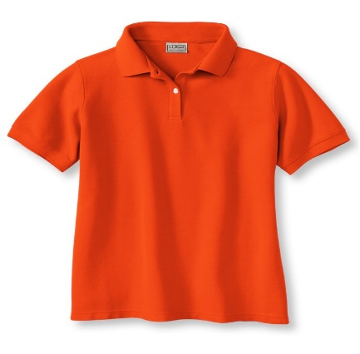
Norma de Origen “Yarn-forward”
Hilado Tejido Prendas
Notes:
BEFORE SPEAKING ABOUT SHORT SUPPLY, IT IS IMPORTANT TO UNDERSTAND THE TEXTILE AND APPAREL RULES OF ORIGIN IN THE AGREEMENT. ALL TEXTILE OR APPAREL GOODS THAT MEET THE RULE OF ORIGIN ENTER THE U.S. FREE OF DUTY.
THE YARN FORWARD RULE OF ORIGIN REQUIRES THAT ALL APPAREL GOODS ENTERING THE U.S. FROM COLOMBIA MUST BE MADE OF REGIONAL YARNS AND REGIONAL FABRICS.
FOR EXAMPLE, A YARN SPUN IN THE U.S. IS SENT TO COLOMBIA WHERE THE YARN IS CONVERTED TO A KNIT FABRIC AND THE KNIT FABRIC IS THEN SENT TO AN APPAREL MANUFACTURER IN MEDELLIN WHERE THE FABRIC IS CUT AND THEN ASSEMBLED INTO A SHIRT. THE COLOMBIA-MADE SHIRT WOULD ENTER THE U.S. DUTY-FREE UNDER THE U.S.-COLOMBIA TPA.
IF THE SHIRT WERE MADE IN COLOMBIA OF YARNS AND/OR FABRIC OF A 3RD COUNTRY, THE SHIRT WOULD BE SUBJECT TO THE FULL TARIFF WHEN ENTERING THE U.S.
HOWEVER, IF YARNS AND/OR FABRIC OF A 3RD COUNTRY ARE ON THE SHORT SUPPLY LIST, THEN THE SHIRT COULD ENTER THE U.S. DUTY-FREE.

Slide 3
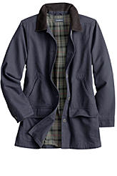
“Carácter Esencial”
Notes:
THE YARN FORWARD RULE OF ORIGIN ONLY APPLIES TO THE MAIN COMPONENT - OR ESSENTIAL CHARACTER - OF THE GARMENT. THE RULE OF ORIGIN DOES NOT APPLY TO COLLARS, CUFFS, OR OTHER ACCESSORIES IN A GARMENT.

Slide 4




“Carácter Esencial Plus +”
Telas elásticas estrechas
Forros visibles
Hilo (algodón, filamento)
Bolsillos
Notes:
HOWEVER, thread, narrow elastic fabrics, visible linings, and pocket bag fabrics MUST ORIGINATE. IN OTHER WORDS, IN ADDITION TO THE YARN FORWARD RULE FOR THE MAIN COMPONENT OF A GARMENT, THE ITEMS LISTED ON THIS SLIDE ALSO HAVE TO BE FROM EITHER COLOMBIA OR THE U.S.

Slide 5

Short Supply / Escaso Abasto
Fibras, Hilado o Tejidos “no disponibles comercialmente” en la región TLC (EEUU y Colombia)
Pueden ser abastecidos de fuera de la región para su uso en bienes calificados
Lista de Mercancías en Escaso Abasto (Anexo 3-B)
Notes:
THERE IS A SPECIFIC LIST OF TEXTILE PRODUCTS THAT ARE IN SHORT SUPPLY. AND, THERE IS A DETAILED PROCESS FOR ADDING FIBERS, YARNS, OR FABRICS TO THE SHORT SUPPLY LIST. AND, AS YOU ARE AWARE, THE SHORT SUPPLY PROCESS IS ADMINISTERED BY THE U.S.
IN A MOMENT, MY COLLEAGUE, LAURIE MEASE, WILL PROVIDE MORE INFORAMTION ABOUT THE PROCESS OF ADDING A PRODUCT TO THE SHORT SUPPLY LIST.
.

Slide 6
Uso del Mecanismo de Escaso Abasto
Apparel shipments to the U.S., 2017
 |  | imports of apparel ($ millions) | SS products | added under SS process | SS as a percent of apparel imports
NAFTA |  | $4,380 | 10 | 10 | n/a
CAFTA-DR |  | $8,051 | 150 | 80 | 4.70%
Colombia |  | $194 | 21 | 3 | less than 1%
Peru |  | $608 | 18 | 0 | less than 1%
Notes:
ABOVE PROVIDES A VERY BRIEF STATISTICAL OVERVIEW OF THE APPAREL TRADE FROM OUR LARGEST SUPPLIERS IN THE AMERICAS REGION.
THE DATA COMPARES THE DIFFERENT FREE TRADE AGREEMENT COUNTRIES’ USE OF THE SHORT SUPPLY PROVISION.
THE 1ST COLUMN IDENTIFIES TOTAL IMPORTS OF APPAREL TO THE U.S. IN 2017, MEASURED BY VALUE (MILLIONS/USD).
THE 2ND COLUMN IDENTIFIES THE NUMBER OF SHORT SUPPLY PRODUCTS ON THE SHORT SUPPLY LIST FOR EACH FREE TRADE AGREEMENT.
THE 3RD COLUMN IDENTIFIES HOW MANY SHORT SUPPLY PRODUCTS (YARN AND FABRICS) HAVE BEEN ADDED TO THE SHORT SUPPLY LIST UNDER THE SHORT SUPPLY PROCESS.
AND THE 4TH COLUMN IDENTIFIES THE PERCENTAGE OF APPAREL SHIPPED TO THE U.S. ENTERING USING THE SHORT SUPPLY PROVISION – THIS IS APPAREL MADE USING 3RD PARTY YARNS OR FABRIC ON THE SHORT SUPPLY LIST.
I WILL NOW ALLOW LAURIE TO PROVIDE MORE DETAILED INFORMATION ABOUT THE SHORT SUPPLY PROCESS.

Slide 7
Mecanismo de Escaso Abasto
U.S.-Colombia TPA allows duty-free treatment for certain products (fibers, yarns, or fabrics) that are not “commercially available” in the U.S. or Colombia.
These products may be sourced outside the region and be treated as “originating,” with no end-use restriction.
Products that currently qualify under this provision are included in the “Short Supply List” (Annex 3-B).
Notes:
What short supply IS: “No U.S. or Colombian suppliers are capable of making this product or one that is substitutable.”
What short supply ISN’T: “Even though U.S. or Colombian suppliers make the product, the price is too high.”

Slide 8

Mecanismo de Escaso Abasto
After receiving a request for a particular product, CITA, an inter-agency committee, determines if that product is not commercially available.
BUT, CITA does not contact potential suppliers to investigate whether the product is available.
CITA is the adjudicating authority. CITA does not collect information – it only reviews information submitted on the record.
Interested entities submit evidence to CITA to support their claims as to the commercial availability of the subject product, and CITA makes its determination based ONLY on that evidence.

Slide 9
Timeline for Short Supply Proceedings
Day 0: A Request is submitted to CITA.
CITA has 2 business days to accept or reject the Request after it considers whether:
  Due diligence to source the specified product is reasonable and sufficient;
  Product description and requirements are reasonable;
  Product cannot be substituted.
If CITA accepts, the Request is posted and parties are notified.
Potential suppliers have 8 business days to submit a Response with an Offer to Supply, with information demonstrating their capability.
The Requestor may rebut a potential supplier’s claim within 4 business days.
CITA may request a public hearing for more information, but will make its determination in 30-44 business days.
If approved, product is added to Annex 3-B.

Slide 10

The Short Supply Process:
“Due Diligence” is CRITICAL!
Because CITA does not collect information, interested entities must provide evidence based on their “due diligence.”
For requestors, due diligence is a reasonable effort to source the product from U.S. or Colombian suppliers.
For potential suppliers, due diligence is the offer to supply the product, and a demonstration that they can produce it or one that is substitutable.

Slide 11
Downstream Products and Finishing
CITA does not accept Requests where the product that’s unavailable
isn’t the final “downstream” product, but one of its inputs.
For example, if the inquiry is for a fabric that calls for a specific yarn, and a supplier can make the fabric but the yarn isn’t available in the U.S. or Colombia, the supplier should say so in its response to the requestor.
In the same way, CITA also does not accept Requests where the only aspect of the product that’s “unavailable” is a finishing process.
If a supplier identifies that it is only a production input (i.e. fiber or yarn) or a finishing process that’s unavailable, clearly state this in a Response.

Slide 12
What Must a Potential Supplier Provide?
Offer to supply the specified product or one substitutable.
Provide detailed information on production capacity and capability.
Identify all sub-contractors.
Not required to provide business proprietary information.
Not required to provide samples.

Slide 13
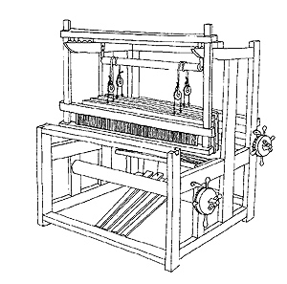
Information on Supplier’s Production Capability
A supplier must substantiate its claim to be able to supply the product by
providing certain information. A requestor may ask that a supplier:
Provide quantity of the product, or one(s) similar, that the supplier has produced in the last 24 months.
Provide other information demonstrating its ability to produce the product, such as:
Equipment to be used,
Current capacity,
Current loom availability, and/or
Timetables to deliver product.
Must provide the name and address of any sub-contractor.
A supplier is not required to disclose business confidential information.

Slide 14

Substitutable Products
A supplier may propose another product that it believes is substitutable for the product specified.
A supplier should explain why it believes the product is an acceptable substitute, referencing measurable criteria whenever possible.
If the requestor does not accept the proposed substitute, it must provide an explanation to the supplier why it is not substitutable.
However, the requestor may NOT base their explanation on customer preference or any other non-measureable criteria.

Slide 15

Providing Samples
While a requestor may ask for a sample, a supplier is not required to provide one.
If a supplier does offer to supply a sample, it may require payment or a minimum purchase order.
Both the requestor and supplier should explain their standard business practice on samples.
Even if the supplier provides a sample, it must still provide detailed information to support its claim that it can produce the subject product.
A requestor may test a sample to determine if it meets specifications.

Slide 16

Price is NOT a Factor
CITA does NOT consider whether the product is available outside the region at a lower price.
As long as a potential supplier can demonstrate it can produce the subject product or one substitutable, price is irrelevant.

Slide 17

Documenting Due Diligence
Memorialize and document all communications with (e.g. copy all emails and notes of telephone conversations), including the name of the inquirer.
Collect any documentation (e.g. specification sheets and test results) that the requestor provided relating to the specified product.
Be sure to keep copies of all documentation that you provide to the requestor.

Slide 18
Tips for Suppliers
Make sure you respond to the initial inquiry – indicate if you will respond fully at a later date, or if someone else in the company will respond.
Clarify any questions about the product’s specifications and criteria, its substitutability, and requirements for quantity and deadlines.
Answer ALL outstanding questions from the requestor regarding production capability and normal business practice.
You may consult with other suppliers about the inquiry.
Contact OTEXA if you have any questions.

Slide 19
How to Prepare a New Short Supply Request

Slide 20
First Steps in Preparing a Request
If you think that a product isn’t available in the region, you must compile evidence to support your claim.
Identify the product:
  Reasonable specifications (industry standards)?
  Reasonable deadline and quantities?
  Is there a substitutable product?
Identify potential suppliers, and contact them to confirm whether they can or cannot supply the product.
Collect documents to support your claim.

Slide 21
Product Description
Requestors must include a reasonable product description, both in terms of scope and specifications.
Don’t make the product description too broad.
Make sure you include all relevant specifications for inputs, construction, and finishing processes.
If you include performance requirements, they must have measureable criteria. Identify any relevant testing methods.
Disclose any requirements for testing and quantities.
Include explanations for any specifications or requirements that might be outside industry standards.

Slide 22
Things to Consider in a Product Description
Don’t make the ranges too broad. If a supplier can make ANY PART of that range, that product is not in short supply.
You only need to include relevant specifications.
If you find during due diligence that a supplier can make a certain part of the range, you can narrow the product description when you submit the Request.
Measurable criteria does NOT include “hand” or “feel.”
“Customer preference” is not a valid reason to include a specification.
“Certification” requirements may not be valid.
Notes:
Product description shouldn’t be too narrow either, as that raises the possibility of being unable to meet the narrow definition when importing the finished product. I’ll discuss that further in a minute.

Slide 23
What are Relevant Specifications?
“Relevant specifications” are those that will determine whether a potential supplier has the capability to produce the product.
It is not necessary to include all specifications that would be provided to a supplier (i.e. mill specifications).
Depending on the product, the relevant specifications may be yarn sizes, fiber content, weave types, and/or finishing processes.
If a particular specification, e.g. width, is not going to be a determining factor in whether a supplier is capable of producing the good, then you don’t have to include it in your product description.
However, if width is not specified and a supplier can supply the product, it can provide a product of any width.

Slide 24
Don’t Forget TOLERANCES!
Some physical parameters can change after construction. Dyes and other finishing processes can affect yarn size, thread count, colorization, and weight.
Even though you provide specifications based on construction parameters, take into account how post-construction processes can affect physical characteristics.
Customs tests the imported apparel, NOT the fiber, yarn, or fabric. If test results fall outside specifications, Customs will deny duty-free treatment.
CITA CANNOT MAKE ANY CHANGES to a product description once it has been submitted by a requestor. Expansion of specifications must be made in a new Request.

Slide 25

Commercial Quantities in a Timely Manner
In the course of due diligence, and in its Request, the requestor must indicate the total quantity it requires over a certain period of time, and what, if any, deadlines are involved.
CITA does not require that suppliers have capacity to produce the quantity immediately available, but it must be available in a timely manner.
If CITA finds that the product is available, but not in the quantities requested, it can add the product in a “Restricted Quantity.”
CITA will determine what is considered “timely” on a case-by-case basis, but will typically consider the relative complexity of the subject product.

Slide 26
Identifying and Contacting Potential Suppliers
Requestors may use different ways to identify potential suppliers: industry directories, association memberships, previous supplier contacts from past requests, etc.
Confirm the name, title, and address for the contact, including email and/or phone. You must include this in your Request.
CITA will not reject a Request because not all possible suppliers have been contacted, but you must have contacted a reasonable number of suppliers. Be prepared to justify your choices.
Requestors must attempt to contact a potential supplier at least twice, but it is the supplier’s responsibility to respond to the inquiry.
A potential supplier is not required to respond immediately, but should respond in a timely manner.

Slide 27
Possible Ways to Find Suppliers
Contact U.S. trade associations
  Examples: NCTO, AFMA, USIFI
Contact Colombian trade associations
Davison’s Textile Blue Book: http://www.textilebluebook.net/
Previous short supply requests (found on OTEXA’s website)
Notes:
THESE ARE A FEW EXAMPLES OF WAYS IN WHICH YOU MIGHT IDENTIFY POTENTIAL SUPPLIERS. YOU MAY ALSO KNOW OF OTHERS BASED ON YOUR OWN KNOWLEDGE OF THE INDUSTRY.

Slide 28
Contents of a Due Diligence Inquiry
State that you are trying to source a product that complies with the U.S.-Colombia TPA rules of origin.
Provide the entire product description, including any performance criteria. If anything is outside industry standards, provide justification.
Indicate the quantity required and any deadlines involved.
Ask for a response within a reasonable period of time.
You may use a representative to make initial inquiries, but once a supplier indicates interest, all communications must be between the requestor and the potential supplier.

Slide 29
Price is NOT a Factor
CITA does NOT consider whether the product is available outside the region at a lower price.
As long as a potential supplier can demonstrate it can produce the subject product or one substitutable, price is irrelevant.
Notes:
I mentioned this earlier, but it is worth repeating: PRICE IS NOT A FACTOR.

Slide 30
Customer Preference and Non-Measurable Criteria
CITA does NOT consider customer preference or other non-measureable criteria as reasonable requirements.
Issues regarding price, financing, and means of delivery are considered terms of sale, and are NOT relevant.
CITA bases its determinations on whether a supplier can meet all of the physical specifications included in the product description, and produce the product in a timely manner.
Notes:
Again, “timely manner” is determined on a case by case basis.

Slide 31
What If I Don’t Think the Supplier Is Capable?
If you don’t think a supplier has demonstrated its ability to supply the product as specified, or one that’s substitutable, be sure to:
Tell the supplier why you don’t think they’re capable, or why the product they offer is not substitutable.
Give the supplier an opportunity to respond, and to provide information that supports their claim.
Address the supplier’s arguments, and answer all questions.

Slide 32
Summary: Tips for Requestors
Make sure your product description is reasonable, and that you’ve allowed for tolerances.
Make sure you have reasonably identified potential suppliers, have their correct contact information, and contact them at least twice.
If a supplier indicates that they wish to supply, begin a dialogue. Get enough information to confirm whether the supplier has the necessary capability and capacity.
Answer ALL questions from the supplier – don’t disengage in due diligence.
Document ALL communications with potential suppliers.

Slide 33
Preparing a Request for Submission
Make sure the product description is exactly the same as (or narrower than) the description you gave potential suppliers.
Make sure you have adequately summarized correspondence with potential suppliers, and include documentation.
If a supplier has offered to supply, explain why you think the supplier is not capable.
Be sure to follow CITA’s procedures and meet all requirements.
Contact OTEXA if you have any questions.

Slide 34


Don’t Forget!
Submit your Request in both a hard copy (an original signed version, delivered to the Chairman of CITA), and an electronic copy (in either PDF or Word).
A Request must include a Due Diligence Certification that all information is accurate.

Slide 35
After the Request is Submitted
Be prepared: a supplier you may have contacted during due diligence can still submit a Response with an Offer to Supply.
If you don’t think that the supplier has demonstrated its capability to supply the product or one that is substitutable, you can submit a Rebuttal.
Address ALL of the supplier’s claims and explain why you don’t think it is capable of supplying the product.
CITA may call for a public meeting. This is the LAST opportunity to present your arguments and evidence.

Slide 36
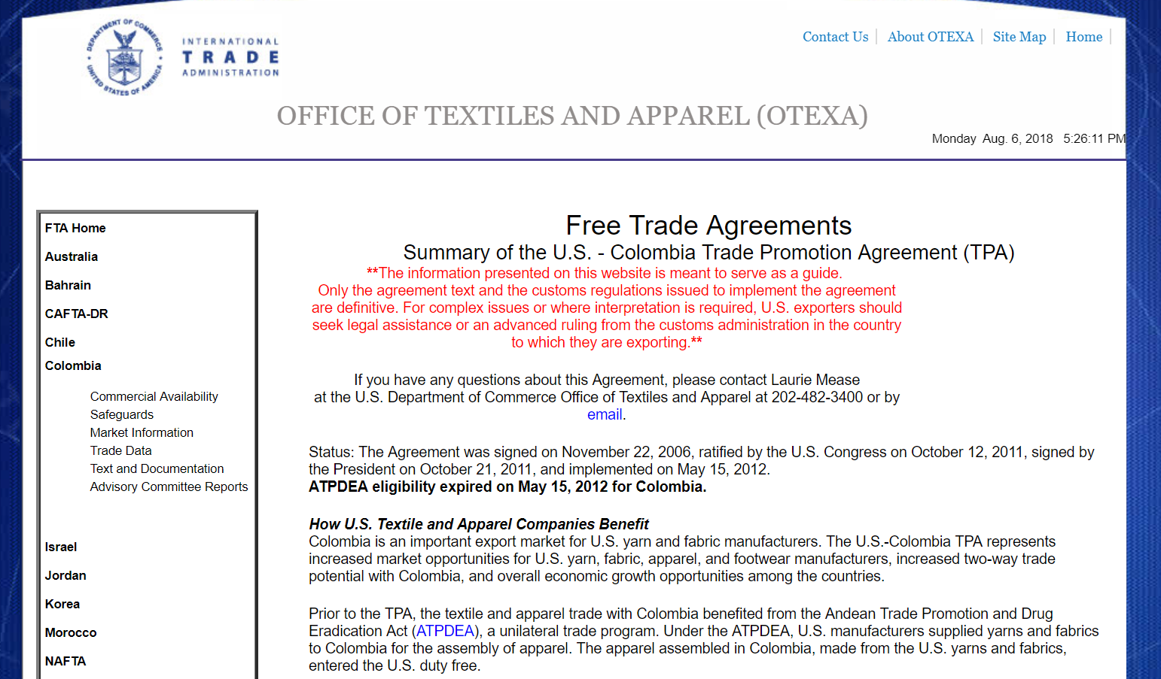
OTEXA Website
http://otexa.trade.gov
Notes:
THE RULES OF ORIGIN AND THE SHORT SUPPLY PROCESS CAN BE COMPLICATED. OF COURSE YOU CAN ALWAYS CONTACT OUR OFFICE IF YOU HAVE QUESTIONS OR SEE OUR WEBSITE, WHERE WE HAVE A FAIRLY COMPREHENSIVE GUIDE TO THE TEXTILE PROVISIONS OF THE TRADE AGREEMENT AND THE RULES OF ORIGIN.

Slide 37
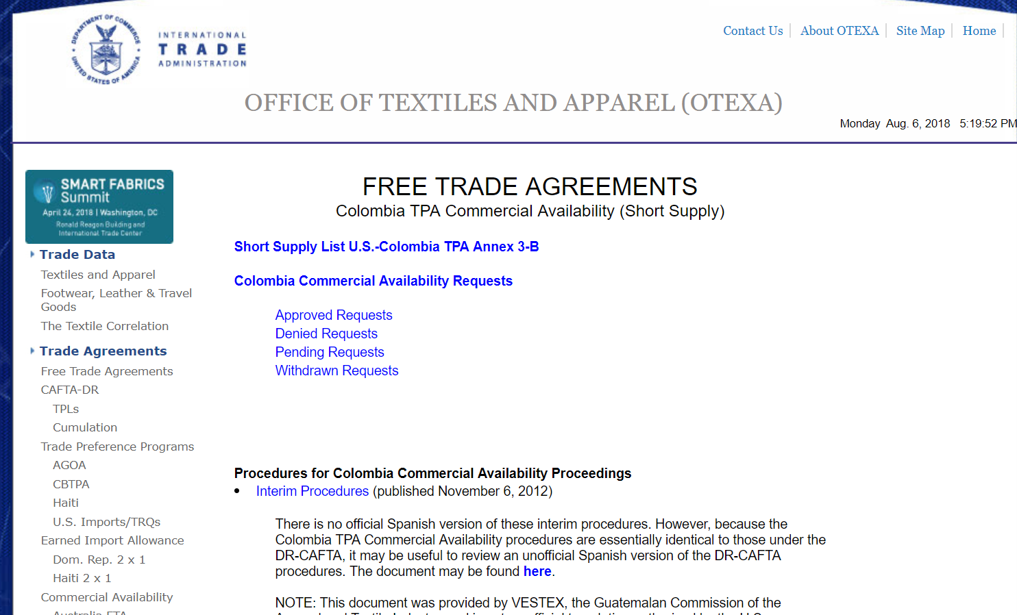
OTEXA Website
https://otexa.trade.gov/ca/ca_Colombia.htm
Notes:
YOU WILL FIND THE SHORT SUPPLY SECTION OF OUR WEBSITE ESPECIALLY HELPFUL. HERE YOU WILL FIND COPIES OF PREVIOUS SHORT SUPPLY REQUESTS, WHICH MAY HELP YOU IN PREPARING YOUR OWN REQUEST.
YOU WILL ALSO FIND CITA’S PROCEDURES HERE, WHICH OUTLINE THE REQUIREMENTS FOR A NEW REQUEST, AN OFFER TO SUPPLY, AND THE OTHER STEPS IN THE PROCESS.

Slide 38
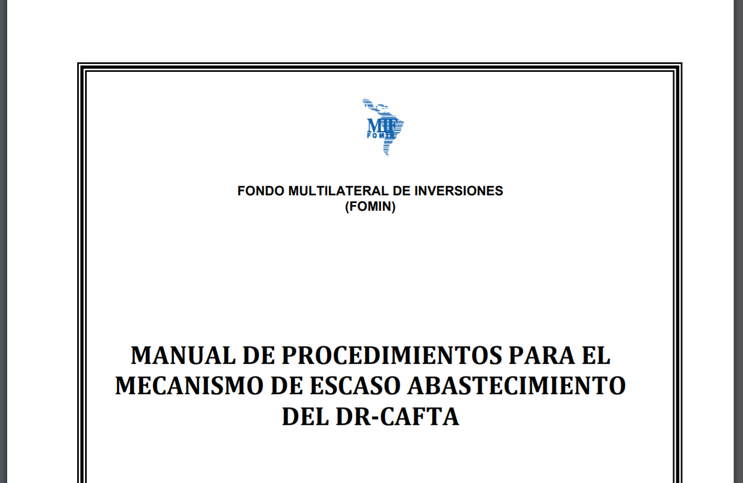
OTEXA Website
https://otexa.trade.gov/PDFs/Manual_de_Short_Supply.pdf
Notes:
FINALLY, I WANT TO POINT OUT THAT ON THE CAFTA SHORT SUPPLY PAGE, WE HAVE A LINK TO AN UNOFFICIAL TRANSLATION OF THE CAFTA-DR PROCEDURES IN SPANISH. THESE PROCEDURES ARE VERY SIMILAR TO THE PROCEDURES YOU WILL USE UNDER THE U.S.-COLOMBIA TPA, SO YOU MAY FIND THEM HELPFUL.
HOWEVER, KEEP IN MIND THAT CITA’S OFFICIAL PROCEDURES ARE IN ENGLISH, AND IF THERE IS ANY DISCREPANCY, THE OFFICIAL ENGLISH PROCEDURES WILL PREVAIL.

Slide 39

Contactos
Richard Stetson and Laurie Mease
Office of Textiles and Apparel (OTEXA)
Richard.Stetson@trade.gov
Laurie.Mease@trade.gov
Tel: +1 (202) 482-3400
¡Muchas Gracias!

